Slide 1
Warehouse Management System (WMS)
By Prakhar Punj 220150011 DSAI

Slide 2
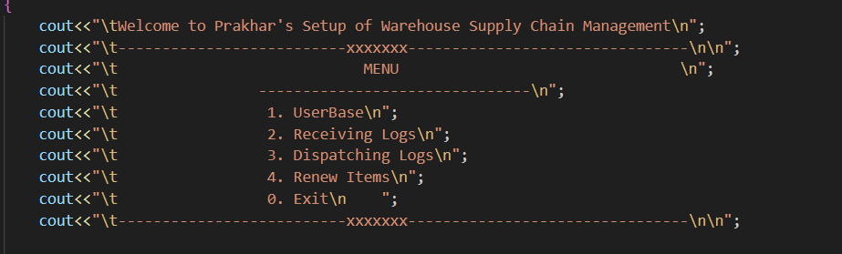
Brief Overview
The Entire Project has 4 Parts:
USER Authentication
Maintaining Entry LogBook
Maintaining Exit LogBook
Renewal System Of Items

Slide 3
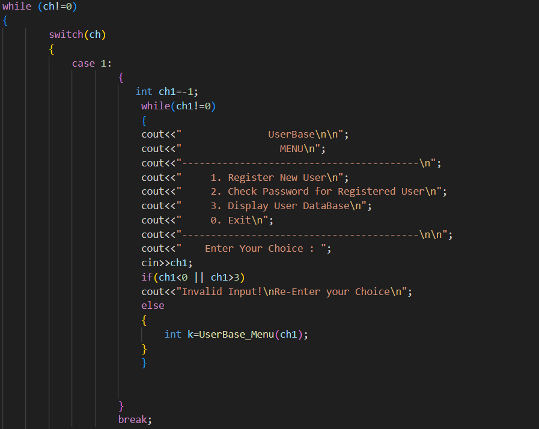
1.USER Authentication
Implemented Using Hashing(SHA)
By default: Username: admin Password: 41
Operations that can be performed: Register a new User Check Password Display User Database

Slide 4
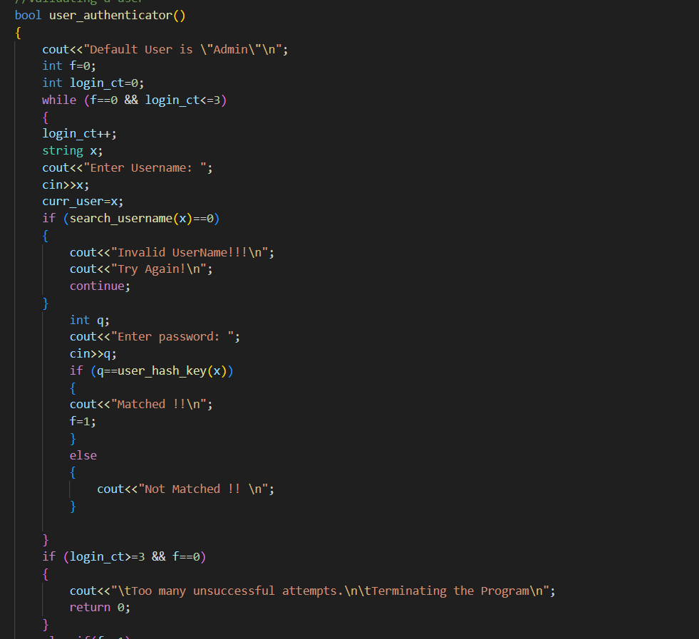
User Authenticator Function To check the Validity of a user using the system.

Slide 5
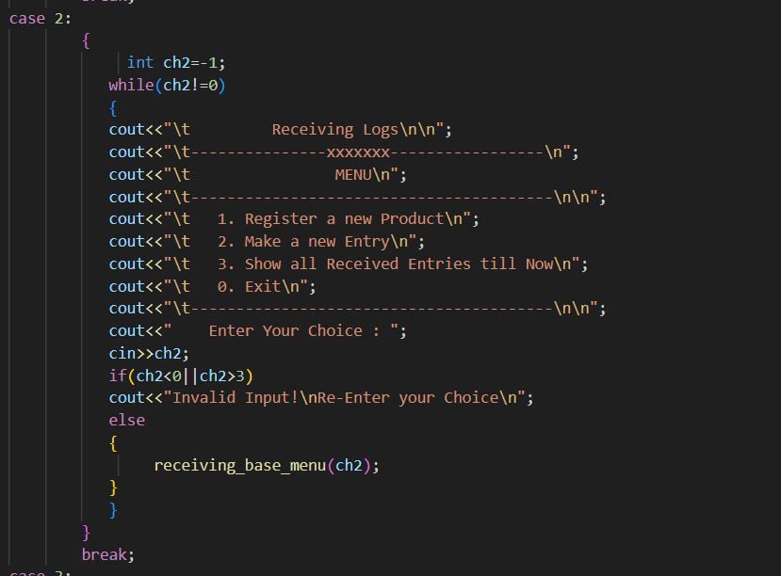
2. RECEIVING LOGS
This module performs all the operation when an item comes to the warehouse. It uses data structures like Array, Linked List and Arrays of Linked list.
It majorly consists of operations:
Register a new Product Make a new Entry
All Received Items The Most Important Feature is to order received Supplies by their Expiry Date

Slide 6
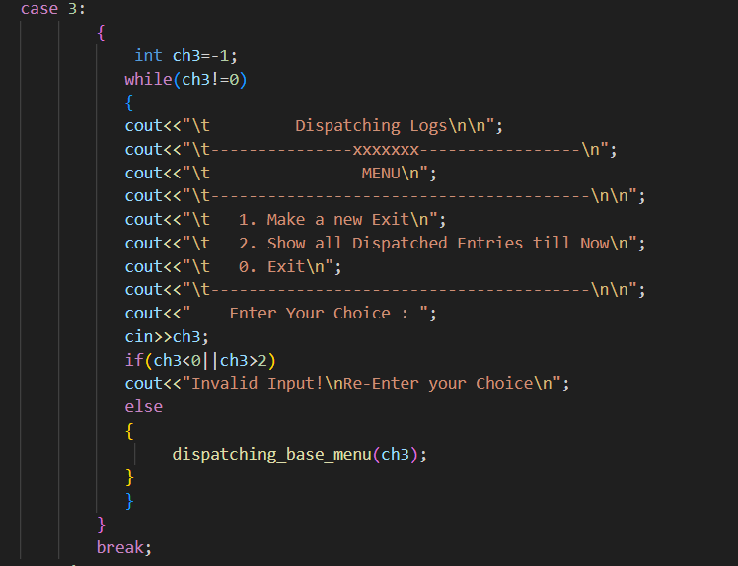
3. DISPATCHING LOGS
This Module Performs all the Dispatching Operations . It majorly consists of operations: Make a new Exit
All Dispatched Items

Slide 7
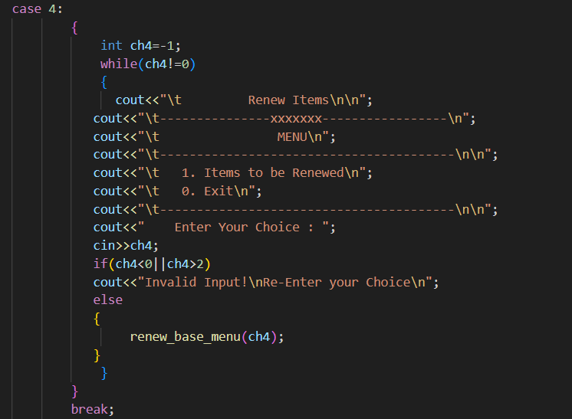
4. RENEWAL SYSTEM
Whenever a product goes below its Threshold Value, It will be shown to the Admin.
It helps the user to maintain shorted supplies easily and at one place.

Slide 8


